Slide 1

Usability of Marginal Data
Jyothi Thimmapuram
Bioinformatics Core Director
jyothit@purdue.edu
bioinformatics@purdue.edu
www.bioinformatics.purdue.edu
ISMB 2018
June 7, 2018

Slide 2
Marginal Data
Marginal: close to the lower limit of qualification, acceptability, or function; barely exceeding the minimum requirements; almost insufficient
Not ideal or optimal to address the hypothesis for which the data are generated

Slide 3
Experiment Failures
Experimental Design –
  Insufficient replicates
  Wrong type of reads
  Insufficient number of reads
Contamination –
  During sample collection
  In the sequencing facility
  Wrong sample IDs
Data collection –
  Mistakes in lab protocol
  Sequencing machine failures

Slide 4
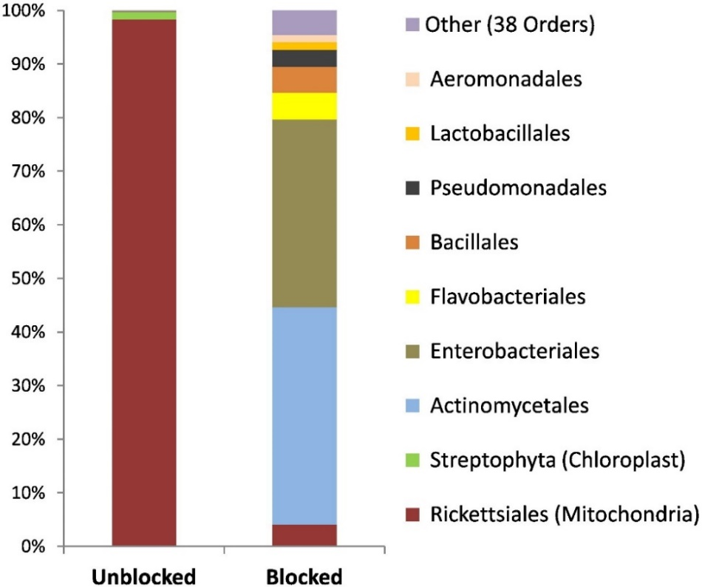
Lab Protocol
Arenz et. al., 2015. J Microbiol Methods. 117:1-3
• Plant DNA can confound molecular studies of bacterial endophytes.
• Blocking primers that greatly increased efficiency of Illumina-based bacterial amplification.

Slide 5
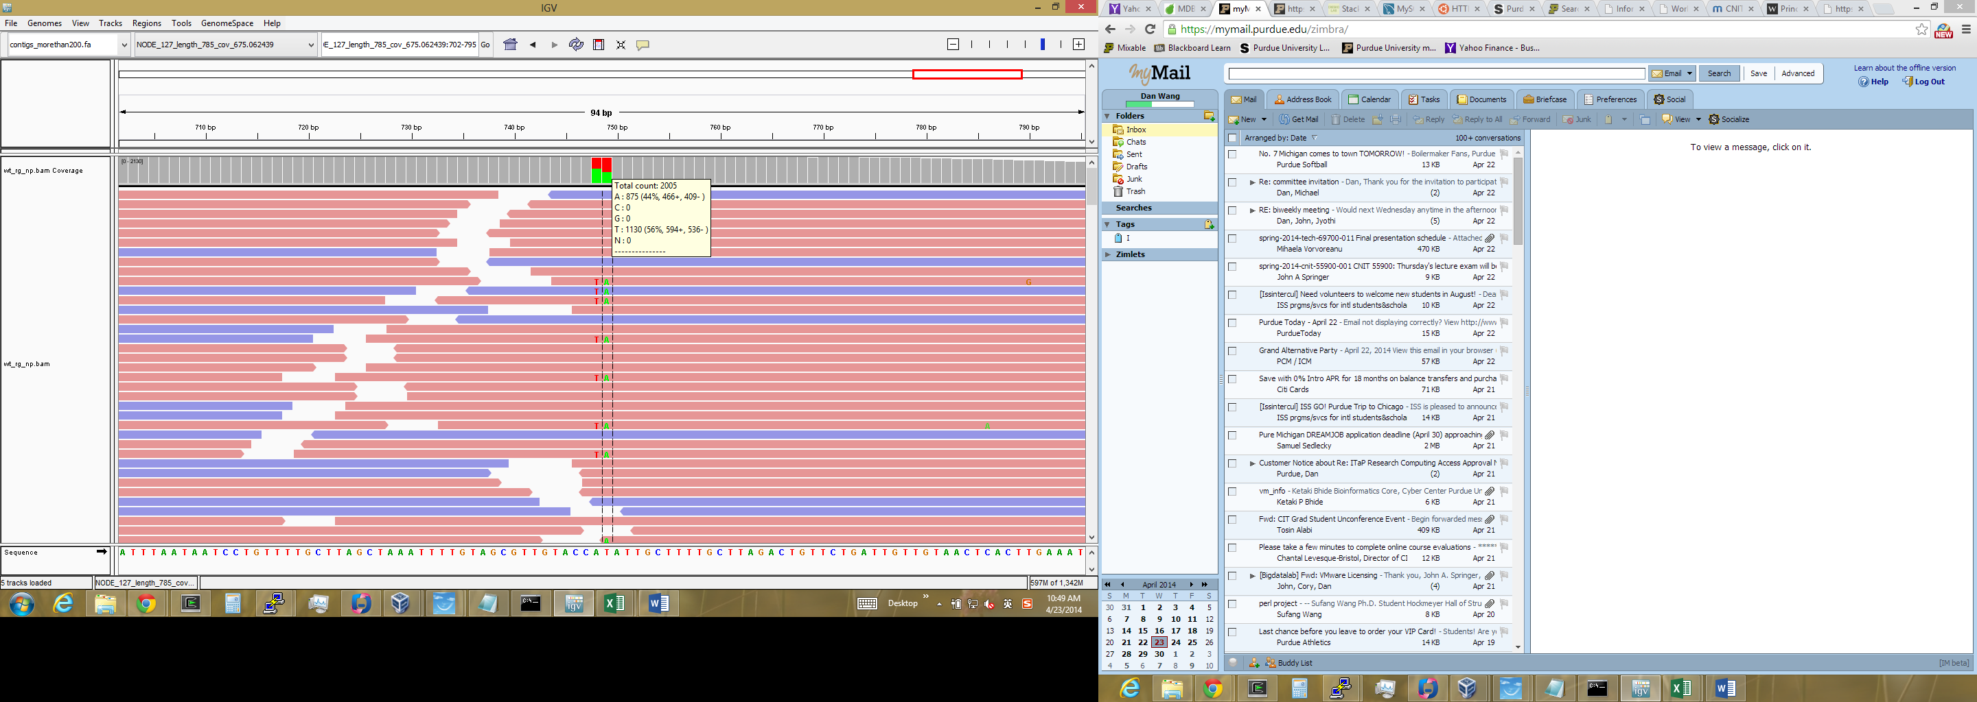
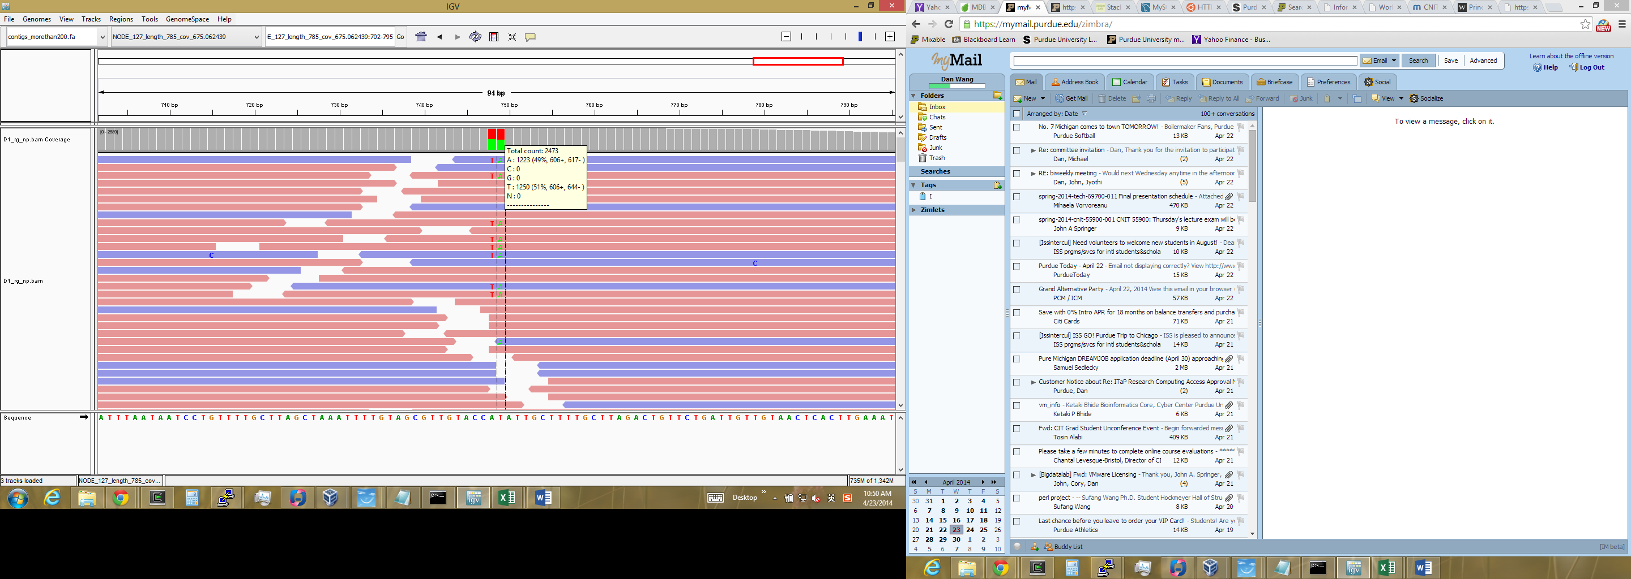
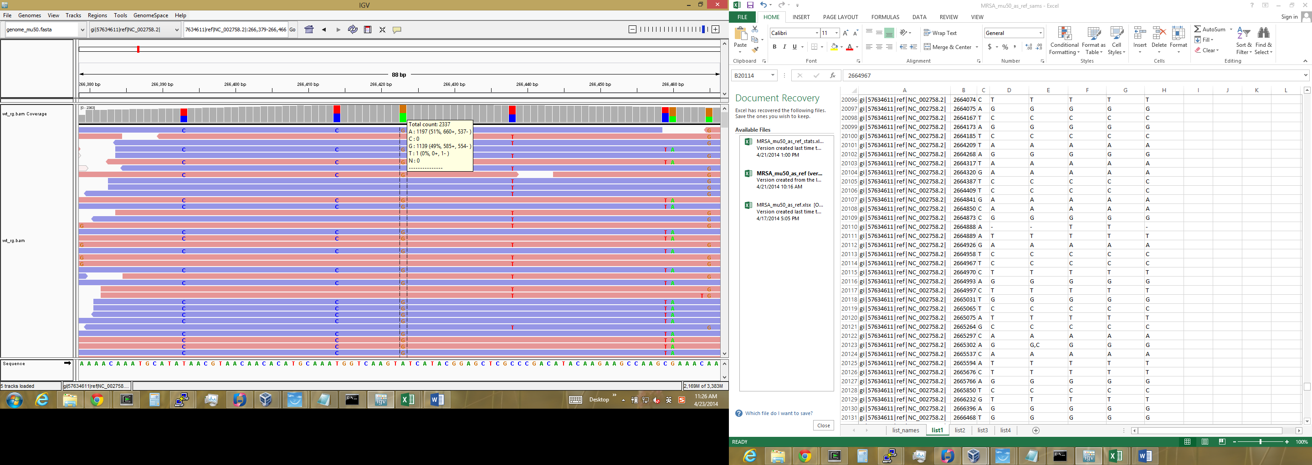
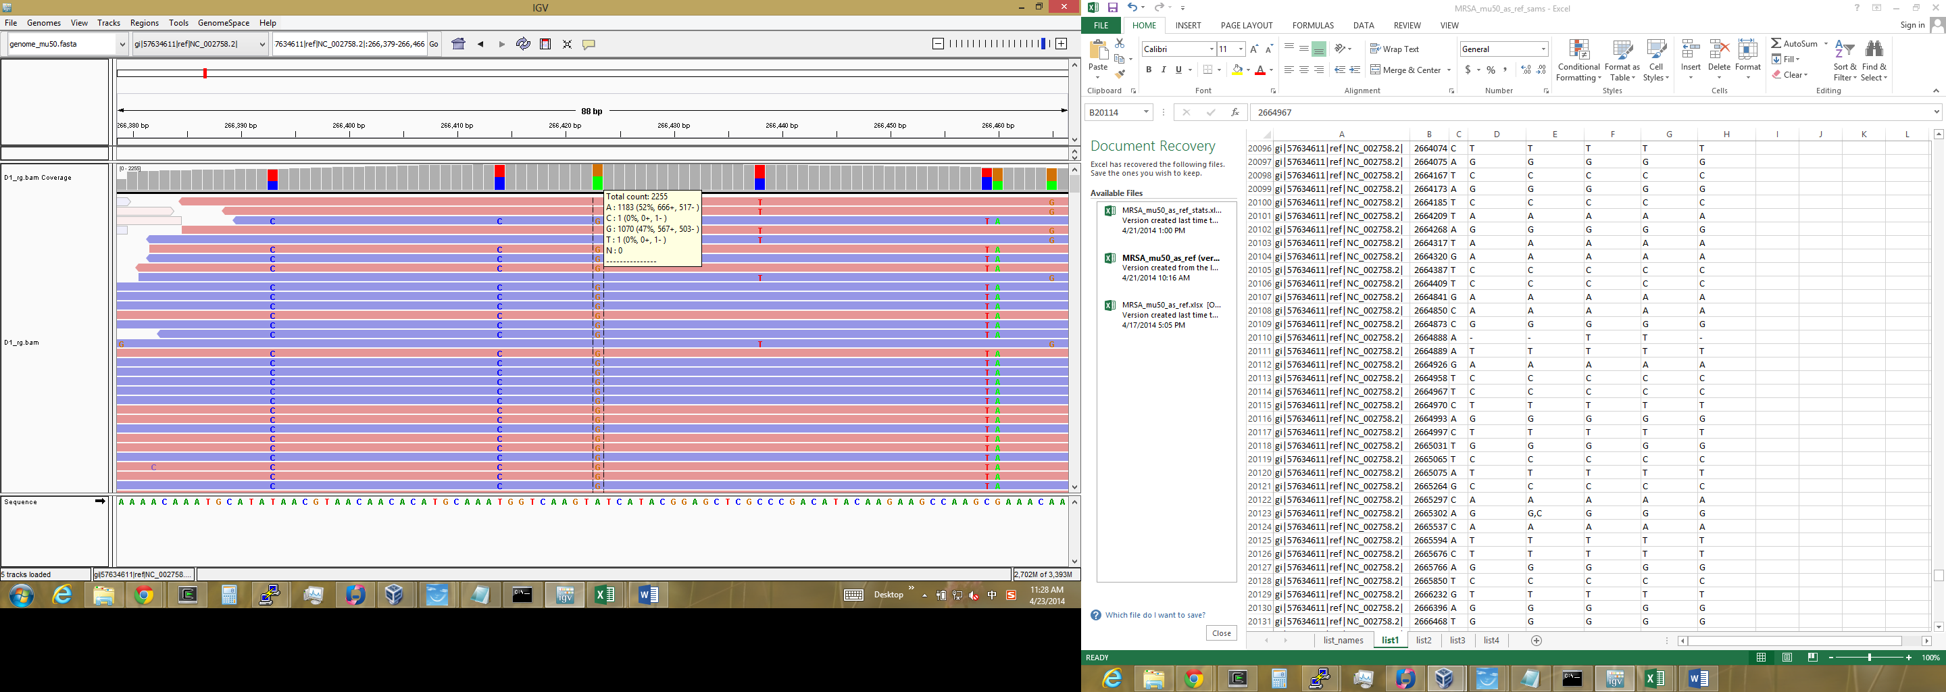
Contamination - Mislabeling
WT
Mutant

Slide 6
Rescuing a failed experiment
Using partial data
eg., using the replicates with enough depth and high quality when many replicates are available.
Re-purpose the data
Maybe you cannot answer the question you started with the data you have, but can answer some other question
eg., RNA-Seq data for transcriptome assembly & characterization

Slide 7
Using partial data
Samples | %Contamination | Samples | %Contamination
Season1_P_Leaf1 | 82.25 | Season2_P_Leaf1 | 9.98
Season1_P_Leaf2 | 82.36 | Season2_P_Leaf2 | 10.01
Season1_P_Root1 | 88.47 | Season2_P_Root1 | 7.64
Season1_P_Root2 | 88.52 | Season2_P_Root2 | 7.66
Season1_S_Leaf1 | 91.73 | Season2_S_Leaf1 | 49.01
Season1_S_Leaf2 | 91.63 | Season2_S_Leaf2 | 49.35
Season1_S_Root1 | 77.07 | Season2_S_Root1 | 12.22
Season1_S_Root2 | 77.17 | Season2_S_Root2 | 12.25

Slide 8
Other uses of marginal data
Guide future experiments for data collection
For eg., mitochondrial/chloroplast blocking primers for plant microbiome 16S amplification
k Bacteria;p Proteobacteria

Slide 9
Data Analysis Failures
Reference genome –
  Genome or transcriptome
  Different version / strains of the reference
Appropriate methods –
  Assembler/ Aligner
  Counting
  Statistical methods
  Missing data

Slide 10
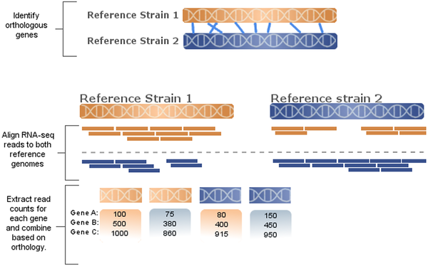
Price A, Gibas C (2017) The quantitative impact of read mapping to non-native reference genomes in comparative RNA-Seq studies. PLOS ONE 12(7): e0180904. https://doi.org/10.1371/journal.pone.0180904

Slide 11
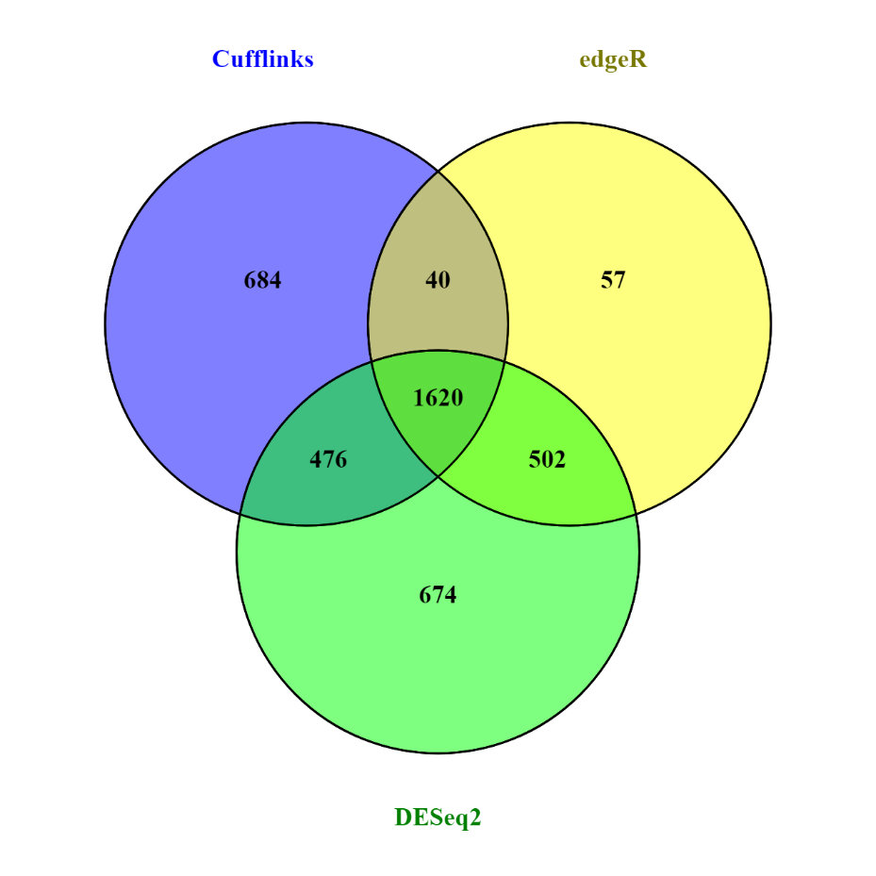
Data Interpretation Failures
FDR 0.05 – 5% probability that we are rejecting the hypothesis even when it is true.
If FDR for ‘YFG” is > 0.05?

Slide 12
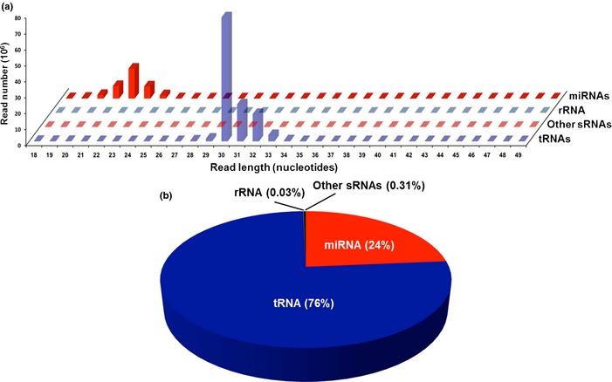
Interpretation of Results
Victoria et. al. 2015. Aging Cell. 14:1055 - 1066
Length distribution and annotation of small RNAs circulating in mice serum. Two major small RNA peaks were detected in the serum from the studied mice: at 20–24 nt, consistent with the size of miRNAs, and at 30–33 nt consisted of reads mapping to tRNA genes (a). A total of 76% and 24% of the total reads mapped to the mouse small noncoding RNAs were derived from tRNAs and miRNAs, respectively (b).

Slide 13
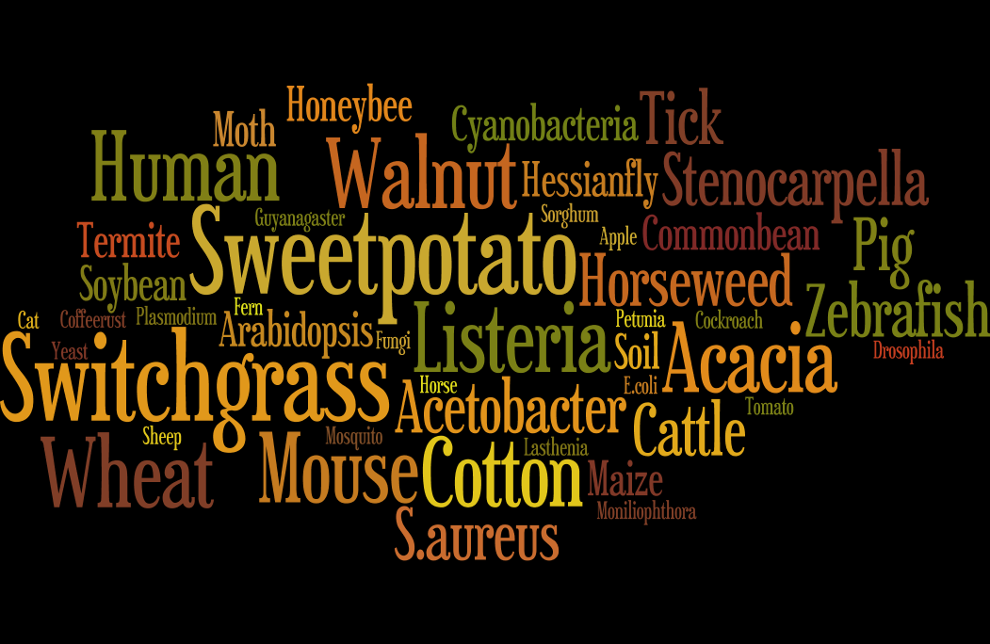
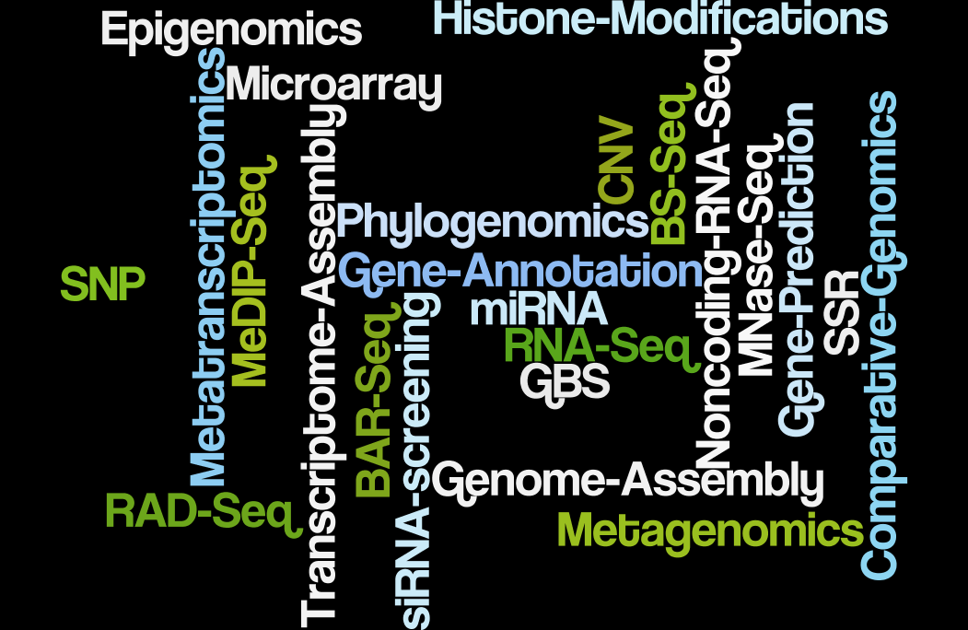

Slide 14
FAILURE MODE
EXPERIMENT
ANALYSIS
Use Partial Data
Re-purpose Data
Guidance for Future Studies
Fixable

Slide 15
Thank you!

